Slide 1
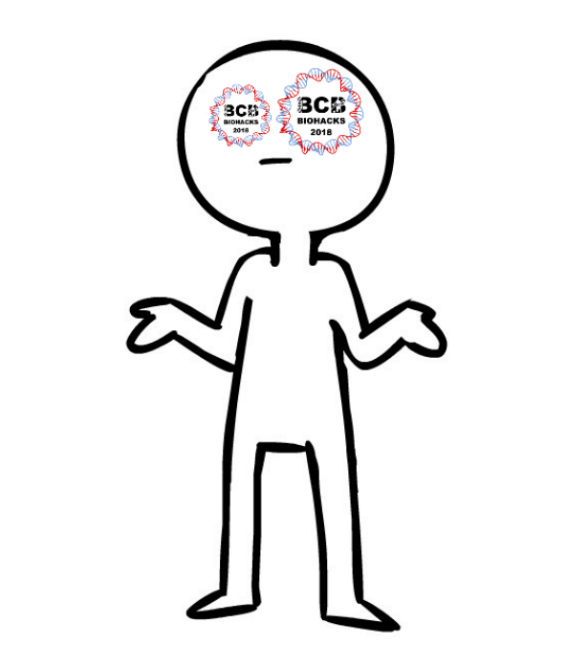

Gene Interaction... And 👉You!
Team Don’t Do Shrugs Kids!
Hammad, Xi, Nada, Tanith, Ramnik, and Alison

Slide 2

The Idea
What makes us human?
The genome is a network of interactions.
The medical impact chromosome 20 has on the body and its functions.
Our goal was a product that was accessible to students all over the world.
Notes:
Tanith

Slide 3
Data Organization
Manual data entry vs. C#.
Python was used for filtering and graphing.
R was used for graphing.
The Human Protein Atlas was used for genetic information.
Notes:
Ramnik

Slide 4
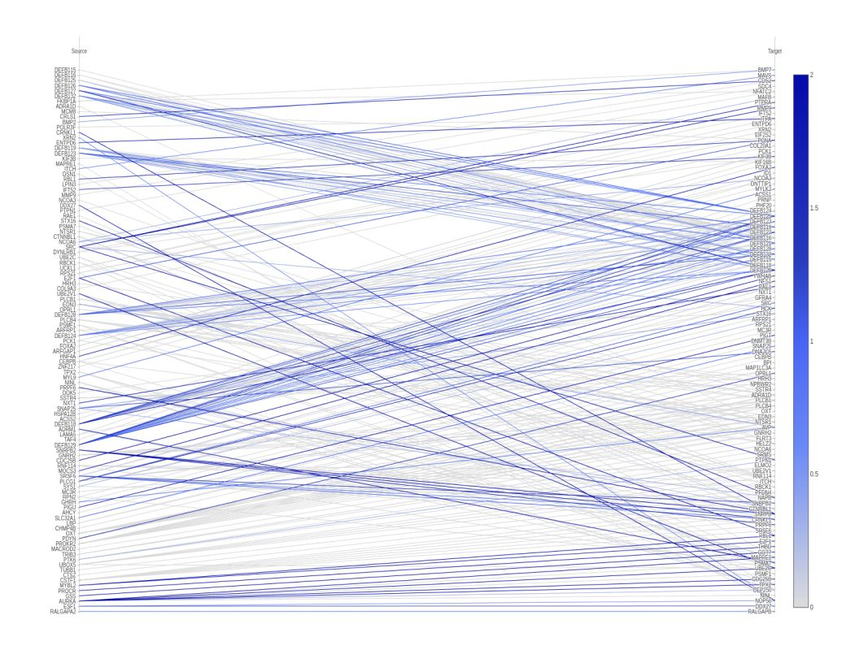
Prototype
The gene-gene interactions are shown in the first portion of the image. The data was taken from Chr20FuncIntx.tsv.
Are there hotspots for interactions, or is it spread out?
A parallel coordinate diagram was used to see where each gene is mapping to, and the strength of the interactions.
The colour scale is a representation normalized scores. The code can therefore be applied to any number of genes.
Notes:
Nada

Slide 5
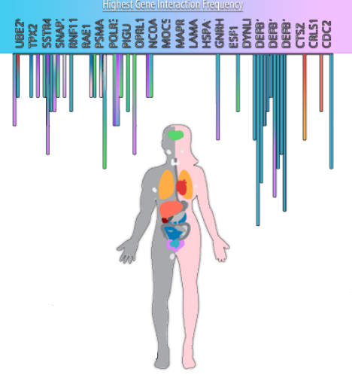
Took the genes with the most interactions and charted the frequency of the interactions.
Data was taken from Chr20FuntIntx.tsv and the Human Protein Atlas.
The coding allows you to see which genes have recurring occurrences.
Colour coded bars allow for mapping to the human body.
Notes:
Hammod

Slide 6
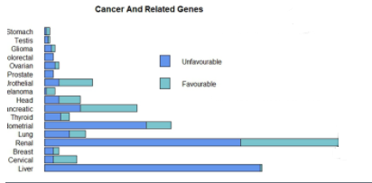
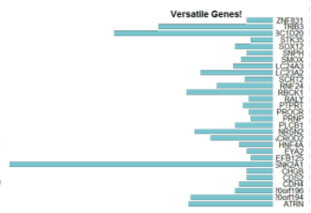
On the left, the function traverses the Chr20GeneData.tsv file and filtered the data into another file.
This file contained cancer types and number of genes associated with each type.
Programming was used to create a graph to show the proportions
On the right, the function traverses the Chr20GWAStraits.tsv file to filter data. Filtered data contains different genes, and number of functions (traits) they’re connected with.
Notes:
Xi

Slide 7
Next Steps
Genome-wide application.
Function that combines two data files according to gene content.
We would like to look into making the image dynamic to target a larger audience.
Make the poster more rich in content by adding descriptions for each graph.
Add intracellular interactions, gene ontology, biological functions.
Expand prognosis analysis to other diseases.
Notes:
Alison

